Slide 1

Module3
. MODULE – III: INTERACTIVE USER INFERFACE AND WEB APPLICATION DEVELOPMENT (10) JavaScript variable naming rules, data types, expressions and operators, pattern matching with regular expressions, managing web page styles using JavaScript and CSS, script forms, introduction to AJAX. Introduction to web design from an evolutionary perspective, create a native and web app, JSX, class and function components, props, state, lifecycle methods, and hooks.

Slide 2
Introduction
JavaScript is a very powerful client-side scripting language.
JavaScript is used mainly for enhancing the interaction of a user with the webpage.
In other words, you can make your webpage more lively and interactive, with the help of JavaScript.
JavaScript is also being used widely in game development and Mobile application development.
JavaScript is an object-based scripting language which is lightweight and cross-platform.
JavaScript is not a compiled language, but it is a translated language. The JavaScript Translator (embedded in the browser) is responsible for translating the JavaScript code for the web browser.

Slide 3
Introduction
Applications
JavaScript is used to create interactive websites. It is mainly used for:
Client-side validation,
Dynamic drop-down menus,
Displaying date and time,
Displaying pop-up windows and dialog boxes (like an alert dialog box, confirm dialog box and prompt dialog box),
Displaying clocks etc.
We can chage the HTML content
Change the attributes of HTML tags
Change the css
Hide and display the content

Slide 4
Document Object Model(DOM)
Why DOM is required?
HTML is used to structure the web pages and Javascript is used to add behavior to our web pages. When an HTML file is loaded into the browser, the javascript can not understand the HTML document directly. So, a corresponding document is created(DOM). DOM is basically the representation of the same HTML document but in a different format with the use of objects. Javascript interprets DOM easily i.e javascript can not understand the tags(<h1>H</h1>) in HTML document but can understand object h1 in DOM. Now, Javascript can access each of the objects (h1, p, etc) by using different functions.

Slide 5
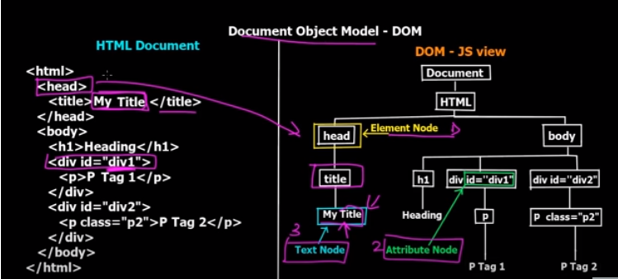
Document Object Model(DOM)

Slide 6

Document Object Model(DOM)
When a web page is loaded, the browser creates a Document Object Model of the page.
The HTML DOM model is constructed as a tree of Objects:
.

Slide 7
Document Object Model(DOM)
With the object model, JavaScript gets all the power it needs to create dynamic HTML:
JavaScript can change all the HTML elements in the page
JavaScript can change all the HTML attributes in the page
JavaScript can change all the CSS styles in the page
JavaScript can remove existing HTML elements and attributes
JavaScript can add new HTML elements and attributes
JavaScript can react to all existing HTML events in the page
JavaScript can create new HTML events in the page
.

Slide 8
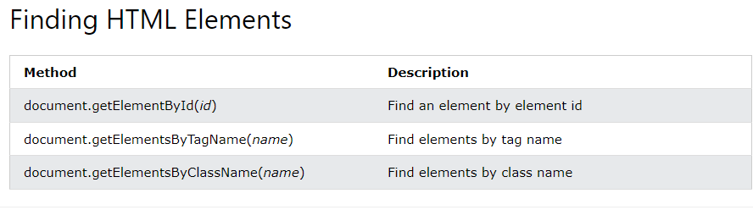
Document Object Model(DOM)

Slide 9
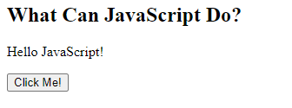
Document Object Model(DOM)
JavaScript Can Change HTML Content
One of many JavaScript HTML methods is getElementById().
The example below "finds" an HTML element (with id="demo"), and changes the element content (innerHTML) to "Hello JavaScript":
Example
<!DOCTYPE html>
<html>
<body>
<h2>What Can JavaScript Do?</h2>
<p id="demo">JavaScript can change HTML content.</p>
<button type="button" onclick='document.getElementById("demo").innerHTML = "Hello JavaScript!"'>Click Me!</button>
</body>
</html>
Note JavaScript accepts both double and single quotes:
document.getElementById('demo').innerHTML = 'Hello JavaScript';

Slide 10
Document Object Model(DOM)
JavaScript Can Change HTML Attribute Values
In this example JavaScript changes the value of the src (source) attribute of an <img> tag:
Example
<body>
<h2>What Can JavaScript Do?</h2>
<p>JavaScript can change HTML attribute values.</p>
<p>In this case JavaScript changes the value of the src (source) attribute of an image.</p>

Slide 11
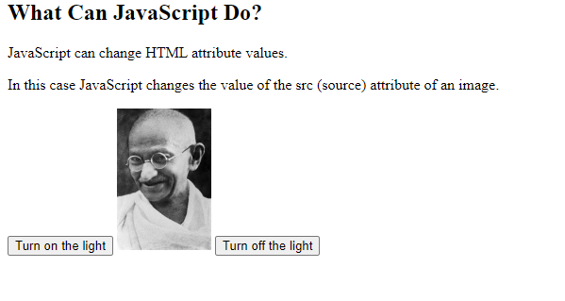
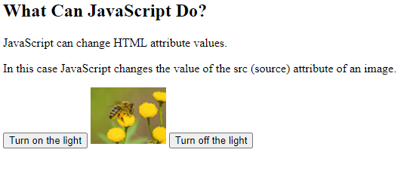
Document Object Model(DOM)
<button onclick="document.getElementById('myImage').src='gandhi.jpg'">Turn on the light</button>
<img id="myImage" src="" style="width:100px">
<button onclick="document.getElementById('myImage').src='honey.jpg'">Turn off the light</button>
</body>

Slide 12
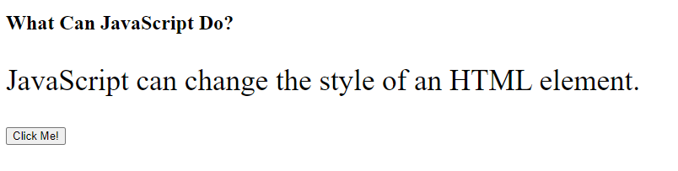
Document Object Model(DOM)
JavaScript Can Change HTML Styles (CSS)
Changing the style of an HTML element, is a variant of changing an HTML attribute:
<body>
<h2>What Can JavaScript Do?</h2>
<p id="demo">JavaScript can change the style of an HTML element.</p>
<button type="button" onclick="document.getElementById('demo').style.fontSize='35px'">Click Me!</button>
</body>

Slide 13
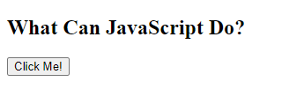
Document Object Model(DOM)
JavaScript Can Hide HTML Elements
Hiding HTML elements can be done by changing the display style:
example
<body>
<h2>What Can JavaScript Do?</h2>
<p id="demo">JavaScript can hide HTML elements.</p>
<button type="button" onclick="document.getElementById('demo').style.display='none'">Click Me!</button>
</body>

Slide 14
Document Object Model(DOM)
JavaScript Can Show HTML Elements
Showing hidden HTML elements can also be done by changing the display style:
Example
<body>
<h2>What Can JavaScript Do?</h2>
<p>JavaScript can show hidden HTML elements.</p>
<p id="demo" style="display:none">Hello JavaScript!</p>
<button type="button" onclick="document.getElementById('demo').style.display='block'">Click Me!</button>
</body>

Slide 15
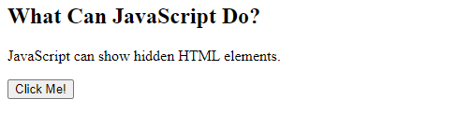
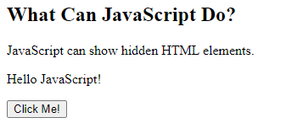
Document Object Model(DOM)
JavaScript Can Show HTML Elements
Showing hidden HTML elements can also be done by changing the display style:
Example
<body>
<h2>What Can JavaScript Do?</h2>
<p>JavaScript can show hidden HTML elements.</p>
<p id="demo" style="display:none">Hello JavaScript!</p>
<button type="button" onclick="document.getElementById('demo').style.display='block'">Click Me!</button>
</body>

Slide 16
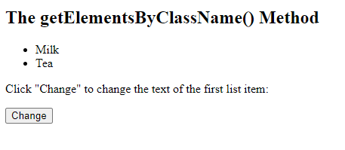
getElementsByClassName() Method
<!DOCTYPE html>
<html>
<head>
<style>
div {
border: 1px solid black;
padding:8px;
}
</style>
</head>
<body>
<h1>The Document Object</h1>
<h2>The getElementsByClassName() Method</h2>

Slide 17
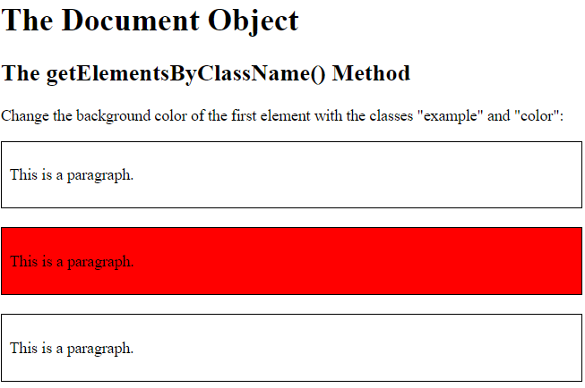
getElementsByClassName() Method
<p>Change the background color of the first element with the classes "example" and "color":</p>
<div class="example">
<p>This is a paragraph.</p>
</div>
<br>
<div class="example">
<p>This is a paragraph.</p>
</div>
<br>
<div class="example">
<p>This is a paragraph.</p>
</div>
<script>
const collection = document.getElementsByClassName("example")[1].
style.backgroundColor = "red";
</script>
</body>
</html>
.

Slide 18
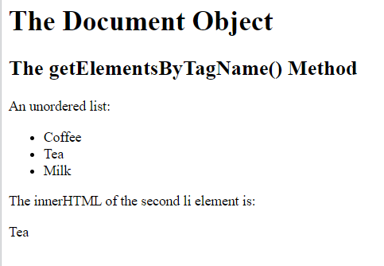
getElementsByTagName() Method
<body>
<h1>The Document Object</h1>
<h2>The getElementsByTagName() Method</h2>
<p>An unordered list:</p>
<ul>
<li>Coffee</li>
<li>Tea</li>
<li>Milk</li>
</ul>
<p>The innerHTML of the second li element is:</p>
<p id="demo"></p>
<script>
const collection = document.getElementsByTagName("li");
document.getElementById("demo").innerHTML = collection[1].innerHTML;
</script>
</body>
.

Slide 19
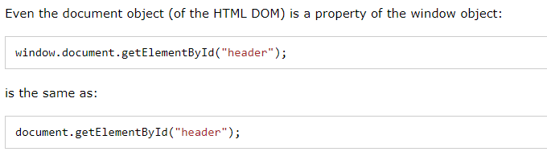
The Window Object
The window object is supported by all browsers. It represents the browser's window.
All global JavaScript objects, functions, and variables automatically become members of the window object.
Global variables are properties of the window object.
Global functions are methods of the window object.

Slide 20
Where to place script tag
Between the body tag of html
Between the head tag of html
In .js file (external javaScript)
Types of JavaScript Comments
There are two types of comments in JavaScript.
Single-line Comment : It is represented by double forward slashes (//)
Multi-line Comment: It is represented by forward slash with asterisk then asterisk with forward slash /* your code here */

Slide 21
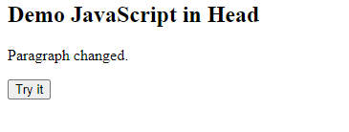
Where to place script tag
Script tag inside head tag
example
<head> <script> function myFunction() { document.getElementById("demo").innerHTML = "Paragraph changed."; } </script> </head> <body><h2>Demo JavaScript in Head</h2> <p id="demo">A Paragraph</p> <button type="button" onclick="myFunction()">Try it</button>
</body>

Slide 22
Where to place script tag
Script tag inside body tag
example
<head> </head> <body><h2>Demo JavaScript in Head</h2>
<script> function myFunction() { document.getElementById("demo").innerHTML = "Paragraph changed."; } </script> <p id="demo">A Paragraph</p> <button type="button" onclick="myFunction()">Try it</button>
</body>

Slide 23
Where to place script tag
To add several script files to one page - use several script tags:
<script src="myScript1.js"></script> <script src="myScript2.js"></script>

Slide 24
Where to place script tag
External JavaScript
Scripts can also be placed in external files:
//externalscript.html
<!DOCTYPE html>
<html>
<body>
<h2>Demo External JavaScript</h2>
<p id="demo">A Paragraph.</p>
<button type="button" onclick="myFunction()">Try it</button>
<p>This example links to "myScript.js".</p>
<p>(myFunction is stored in "myScript.js")</p>
<script src="myScript.js"></script>
</body>
</html>

Slide 25
Where to place script tag
Create file with myscript.js
function myFunction() {
document.getElementById("demo").innerHTML = "Paragraph changed.";
}
JavaScript files have the file extension .js.
To use an external script, put the name of the script file in the src (source) attribute of a <script> tag:

Slide 26
Javascript Output
JavaScript Display Possibilities
JavaScript can "display" data in different ways:
Writing into an HTML element, using innerHTML.
Writing into the HTML output using document.write().
Writing into an alert box, using window.alert().
Writing into the browser console, using console.log().

Slide 27
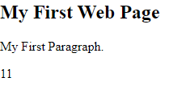
Javascript Output
To access an HTML element, JavaScript can use the document.getElementById(id) method.
The id attribute defines the HTML element. The innerHTML property defines the HTML content:
innerHTML example
<!DOCTYPE html> <html> <body> <h1>My First Web Page</h1> <p>My First Paragraph</p> <p id="demo"></p> <script> document.getElementById("demo").innerHTML = 5 + 6; </script> </body> </html>

Slide 28
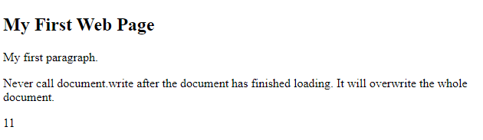
Javascript Output
Using document.write()
<!DOCTYPE html>
<html>
<body>
<h2>My First Web Page</h2>
<p>My first paragraph.</p>
<p>Never call document.write after the document has finished loading.
It will overwrite the whole document.</p>
<script>
document.write(5 + 6);
</script>
</body>
</html>

Slide 29
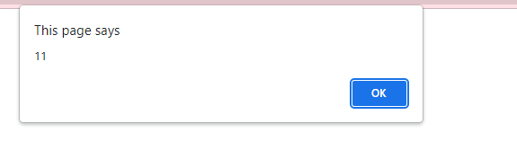
Javascript Output
Using window.alert()
You can use an alert box to display data:
<!DOCTYPE html> <html> <body> <h1>My First Web Page</h1> <p>My first paragraph.</p> <script> window.alert(5 + 6); </script> </body> </html>

Slide 30
Javascript Output
window keyword is optional:
<!DOCTYPE html> <html> <body> <h1>My First Web Page</h1> <p>My first paragraph.</p> <script> alert(5 + 6); </script> </body> </html>

Slide 31
Javascript Output
Using console.log()
For debugging purposes, you can call the console.log() method in the browser to display data.
<!DOCTYPE html>
<html>
<body>
<h2>Activate Debugging</h2>
<p>F12 on your keyboard will activate debugging.</p>
<p>Then select "Console" in the debugger menu.</p>
<p>Then click Run again.</p>
<script>
console.log(5 + 6);
</script>
</body>
</html>

Slide 32
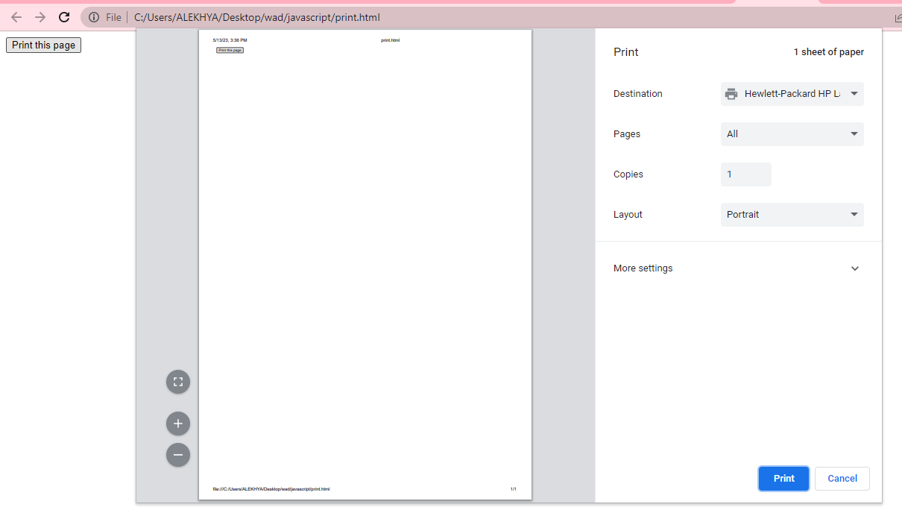
Javascript Output
JavaScript Print
JavaScript does not have any print object or print methods.
You cannot access output devices from JavaScript.
The only exception is that you can call the window.print() method in the browser to print the content of the current window.
<!DOCTYPE html> <html> <body> <button onclick="window.print()">Print this page</button> </body> </html>

Slide 33
Javascript variable naming conventions
JavaScript Identifiers
All JavaScript variables must be identified with unique names.
These unique names are called identifiers.
Identifiers can be short names (like x and y) or more descriptive names (age, sum, totalVolume).
The general rules for constructing names for variables (unique identifiers) are:
Names can contain letters, digits, underscores, and dollar signs.
Names begin with a letter or $ and _
Names are case sensitive (y and Y are different variables).
Reserved words (like JavaScript keywords) cannot be used as name

Slide 34
Javascript variable naming conventions
4 Ways to Declare a JavaScript Variable:
Using var
Using let
Using const
Using nothing
Variables are containers for storing data (storing data values)
Using var
var x = 5; var y = 6; var z = x + y;

Slide 35
Javascript variable naming conventions
Using let
let x = 5; let y = 6; let z = x + y;
Undeclared variables
x = 5; y = 6; z = x + y;
Using const variables(the values cannot be changed)
const price1 = 5; const price2 = 6;

Slide 36
Javascript variable naming conventions
Variables defined with let can not be redeclared.
let x = "John Doe"; let x = 0;(we cannot redeclare like this)
Variables defined with var can be redeclared.
var x = "John Doe"; var x = 0;

Slide 37
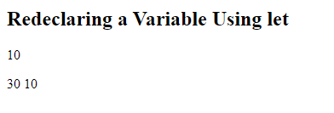
Javascript variable naming conventions
Example
<!DOCTYPE html>
<html>
<body>
<h2>Redeclaring a Variable Using let</h2>
<p id="demo"></p>
<script>
let x = 10;
var y=20;
{
var y=30;
let x = 2;
}
// Here x is 10
document.getElementById("demo").innerHTML = x;
document.write(y+" "+x);
</script>
</body>
</html>

Slide 38
Javascript variable naming conventions
Variables declared with the var keyword can NOT have block scope.
Variables declared inside a { } block can be accessed from outside the block.
{ var x = 2; } // x CAN be used here
Let and const two keywords provide Block Scope in JavaScript
Variables declared inside a { } block cannot be accessed from outside the block:
{ let x = 2; } // x can NOT be used here

Slide 39
Javascript variable naming conventions
<body>
<h2>Redeclaring a Variable Using let</h2>
<p id="demo"></p>
<script>
{
let x = 2;
}
document.write(x);
</script>
</body>

Slide 40
Datatypes
JavaScript provides different data types to hold different types of values.
There are 8 data types in JavaScript. They are as follows:
String 2. Number 3. Bigint 4. Boolean 5. Undefined 6. Null 7. Symbol 8. Object
The Object Datatype
The object data type can contain:
1. An object 2. An array 3. A date

Slide 41
Javascript variable naming conventions
Use const when you declare:
A new Array
A new Object
A new Function
A new RegExp

Slide 42
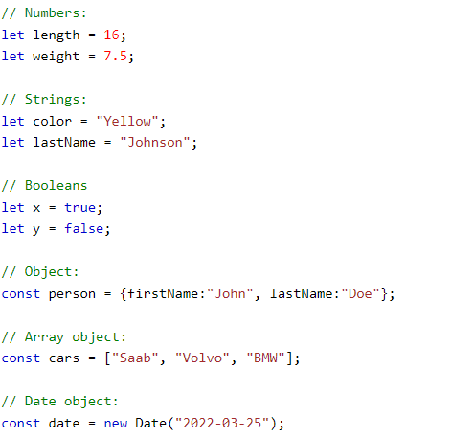
Datatypes
:

Slide 43

Datatypes
Note
When adding a number and a string, JavaScript will treat the number as a string.
JavaScript evaluates expressions from left to right. Different sequences can produce different results:
JavaScript Strings
A string (or a text string) is a series of characters like "John Doe".
Strings are written with quotes. You can use single or double quotes:
Example
<body>
<p id="demo"></p>
<script>
let x = "Volvo" + 16;
let y = 16 + 4 + "Volvo";
document.getElementById("demo").innerHTML = x;
document.write(y);
</script>
</body>

Slide 44

Datatypes
JavaScript Types are Dynamic
JavaScript has dynamic types. This means that the same variable can be used to hold different data types:
example
<p id="demo"></p>
<script>
let x; // Now x is undefined
x = 5; // Now x is a Number
x = "John"; // Now x is a String
document.getElementById("demo").innerHTML = x;
</script>

Slide 45
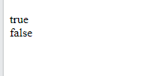
Datatypes
javaScript BigInt
All JavaScript numbers are stored in a a 64-bit floating-point format.
JavaScript BigInt is a new datatype (ES2020) that can be used to store integer values that are too big to be represented by a normal JavaScript Number.
example
let x = BigInt("123456789012345678901234567890");
JavaScript Booleans
Booleans can only have two values: true or false.
<p id="demo"></p>
<script>
let x = 5;
let y = 5;
let z = 6;
document.getElementById("demo").innerHTML =(x == y) + "<br>" + (x == z);
</script>

Slide 46
Datatypes
Constant Objects and Arrays
The keyword const is a little misleading.
It does not define a constant value. It defines a constant reference to a value.
Because of this you can NOT:
Reassign a constant value
Reassign a constant array
Reassign a constant object
But you CAN:
Change the elements of constant array
Change the properties of constant object

Slide 47

Datatypes
JavaScript Arrays
JavaScript arrays are written with square brackets.
Array items are separated by commas.
const cars = ["Saab", "Volvo", "BMW"];
Example
<p id="demo"></p>
<script>
const cars = ["Saab","Volvo","BMW"];
document.getElementById("demo").innerHTML = cars[0];
</script>

Slide 48
Datatypes
JavaScript Objects
JavaScript objects are written with curly braces {}.
Object properties are written as name:value pairs, separated by commas
.
const person = {firstName:"John", lastName:"Doe", age:50, eyeColor:"blue"};

Slide 49

Datatypes
<p id="demo"></p>
<script>
const person = {
firstName : "John",
lastName : "Doe",
age : 50,
eyeColor : "blue"
};
document.getElementById("demo").innerHTML =
person.firstName + " is " + person.age + " years old.";
</script>

Slide 50

Datatypes
The typeof Operator
You can use the JavaScript typeof operator to find the type of a JavaScript variable.
The typeof operator returns the type of a variable or an expression:
<p id="demo"></p>
<script>
document.getElementById("demo").innerHTML =
typeof "" + "<br>" +
typeof "John" + "<br>" +
typeof "John Doe";
</script>

Slide 51
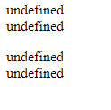
Datatypes
Undefined
In JavaScript, a variable without a value, has the value undefined. The type is also undefined.
Any variable can be emptied, by setting the value to undefined. The type will also be undefined.
example
<p id="demo"></p>
<script>
let car = "Volvo";
car = undefined;
let bike;
document.write(bike+" <br>" +typeof(bike));
document.getElementById("demo").innerHTML = car + "<br>" + typeof (car);
</script>

Slide 52

expressions
JavaScript Expressions
An expression is a combination of values, variables, and operators, which computes to a value.
Example
<body>
<p id="demo"></p>
<script>
document.getElementById("demo").innerHTML = 5 * 10;
</script>
</body>

Slide 53
operators
There are following types of operators in JavaScript.
Arithmetic Operators
Comparison (Relational) Operators
Bitwise Operators
Logical Operators
Assignment Operators
Special Operators

Slide 54
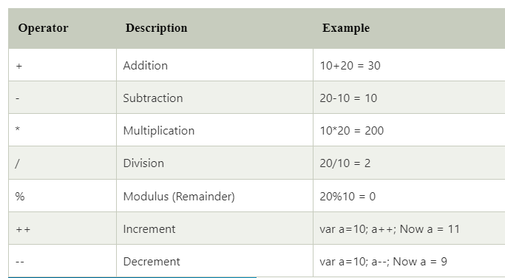
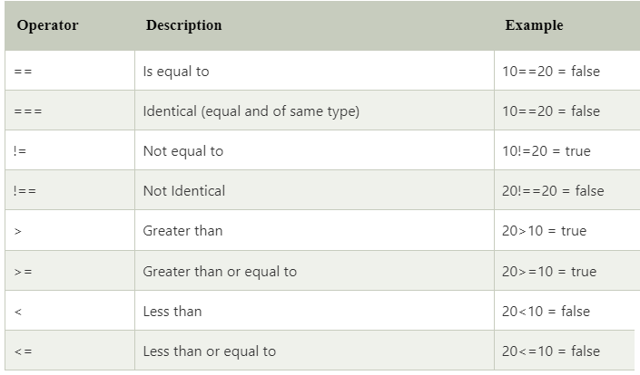
Arithmetic and comparision operators

Slide 55
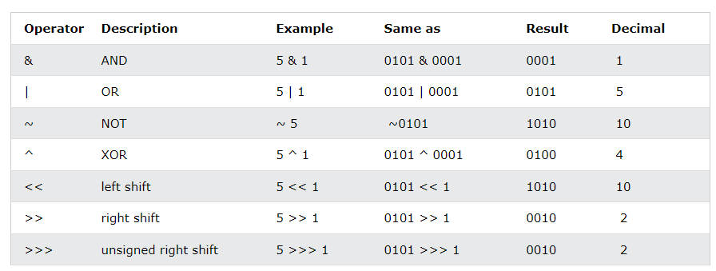
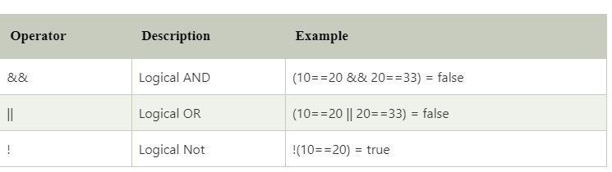
Bitwise and logical operators

Slide 56
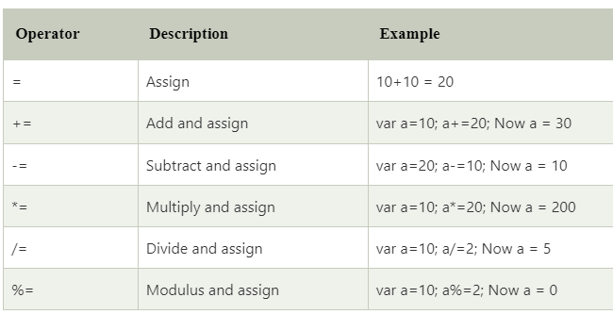
Assignment operators

Slide 57
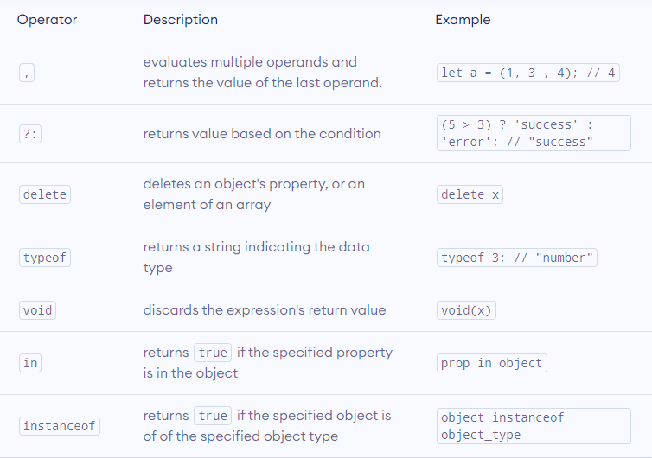
Special operators

Slide 58
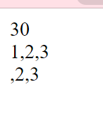
Special operators
Example for delete
<script>
var x=10;
var y=20;
z=x+y;
document.write(z+"<br>");
delete z;
const array=[1,2,3];
document.write(array+"<br>");
delete(array[0]);
document.write(array);
</script>

Slide 59


operators
instance of example
<h3>
Instanceof Operator.
</h3>
<p id="GFG"></p>
<script>
var a = ["Geeks", "for", "Geeks"];
document.getElementById("GFG").innerHTML =
(a instanceof Array) + "<br>" +
(a instanceof Number);
</script>

Slide 60

operators
In example
function gfg() {
// Illustration of in operator
const array = ['geeks', 'for',
'geeks']
// Output of the indexed number
console.log(0 in array);
// Output of the Value
console.log('for' in array);
// output of the Array property
console.log('length' in array);
}
gfg();

Slide 61
loops
There are mainly 3 types of loops in JavaScript.
for loop
while loop
do…while loop
1. for loop:For loop is a simplest loop first we initialized the value then check condition and then increment and decrements occurred.
Syntax:
for(statement1; statement2; statment3)
{
lines of code to be executed
}

Slide 62
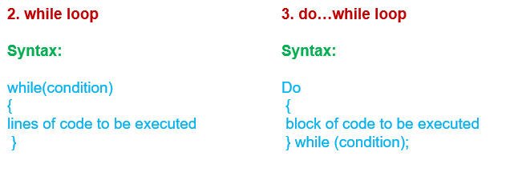
loops

Slide 63
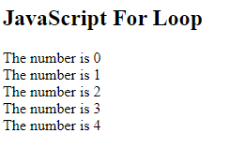
for loop example
<body>
<h2>JavaScript For Loop</h2>
<p id="demo"></p>
<script>
let text = "";
for (let i = 0; i < 5; i++) {
text += "The number is " + i + "<br>";
}
document.getElementById("demo").innerHTML = text;
</script>
</body>

Slide 64
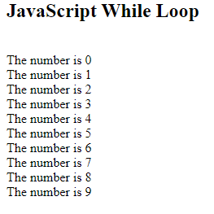
while loop example
<!DOCTYPE html>
<html>
<body>
<h2>JavaScript While Loop</h2>
<p id="demo"></p>
<script>
let text = "";
let i = 0;
while (i < 10) {
text += "<br>The number is " + i;
i++;
}
document.getElementById("demo").innerHTML = text;
</script>
</body>
</html>

Slide 65

For in loop example
<h2>JavaScript for in Loop</h2>
<p id="demo"></p>
<script>
const capitals = {
a: "Athens",
b: "Belgrade",
c: "Cairo"
};
for (let key in capitals) {
console.log(key + ": " + capitals[key]);
}
</script>

Slide 66
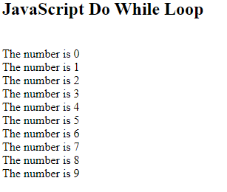
do while loop example
<!DOCTYPE html>
<html>
<body>
<h2>JavaScript Do While Loop</h2>
<p id="demo"></p>
<script>
let text = ""
let i = 0;
do {
text += "<br>The number is " + i;
i++;
}
while (i < 10);
document.getElementById("demo").innerHTML = text;
</script>
</body>
</html>

Slide 67
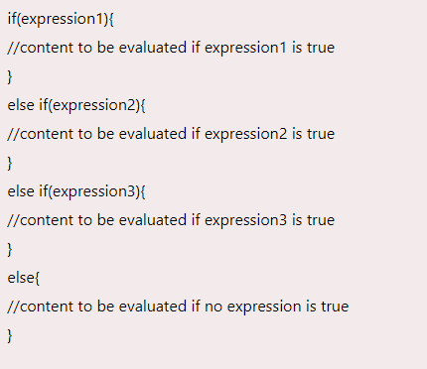
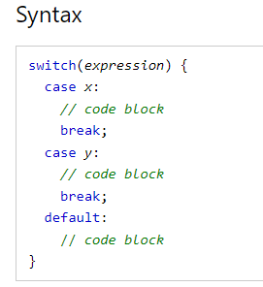
conditions

Slide 68

conditions
Example for if else-if
<script>
var a=20;
if(a==10){
document.write("a is equal to 10");
}
else if(a==15){
document.write("a is equal to 15");
}
else if(a==20){
document.write("a is equal to 20");
}
else{
document.write("a is not equal to 10, 15 or 20");
}
</script>

Slide 69

conditions
Example for switch case
<script>
var grade='B';
var result;
switch(grade){
case 'A':
result="A Grade";
break;
case 'B':
result="B Grade";
break;
case 'C':
result="C Grade";
break;
default:
result="No Grade";
}
document.write(result);
</script>

Slide 70
JavaScript Arrays
An array is an object that can store a collection of items.
Create Array
Syntax:
Var arrayname=[“ list of elements”];
let/var/const array = [ ];
Example
Var branches = [”cse", ”ds", ”it"];
Create an array using Array constructor:
Syntax:
Var arrayname=new Array(“ list of elements”);
Example
var branches = new Array(”cse", ”ds", ”it");
Accessing Array Elements
You access an array element by referring to the index number:
const cars = ["Saab", "Volvo", "BMW"]; let car = cars[0];
Note: Array indexes start with 0.
[0] is the first element. [1] is the second element.

Slide 71
JavaScript Arrays
Arrays are Objects
Arrays are a special type of objects. The typeof operator in JavaScript returns "object" for arrays.
But, JavaScript arrays are best described as arrays.
<!DOCTYPE html>
<html>
<body>
<h2>JavaScript Arrays</h2>
<p>Arrays use numbers to access its elements.</p>
<p id="demo"></p>
<p id ="demo1"></p>
<script>
Const person = ["John", "Doe", 46];
document.getElementById("demo").innerHTML = person[0];
document.getElementById("demo1").innerHTML = typeof(person);
</script>
</body>
</html>
Output:JavaScript Arrays
Arrays use numbers to access its elements.
John
object

Slide 72
JavaScript Arrays
<!DOCTYPE html>
<html>
<body>
<h1>JavaScript Arrays</h1>
<p id="demo"></p>
<script>
const cars = [];
cars[0]= "Saab";
cars[1]= "Volvo";
cars[2]= "BMW";
document.getElementById("demo").innerHTML = cars;
</script>
</body>
</html>
You can also create an array, and then provide the elements:
const cars = []; cars[0]= "Saab"; cars[1]= "Volvo"; cars[2]= "BMW";
JavaScript Arrays
Saab, Volvo, BMW

Slide 73
JavaScript Arrays
Create an array using Array constructor:
<!DOCTYPE html>
<html>
<body>
<h1>JavaScript Arrays</h1>
<p id="demo"></p>
<script>
const cars = new Array("Saab", "Volvo", "BMW");
document.getElementById("demo").innerHTML = cars;
</script>
</body>
</html>

Slide 74
JavaScript Arrays
Changing an Array Element
This statement changes the value of the first element in cars: cars[0] = "Opel";
Example
const cars = ["Saab", "Volvo", "BMW"]; cars[0] = "Opel";
<!DOCTYPE html>
<html>
<body>
<h1>JavaScript Arrays</h1>
<h2>Bracket Indexing</h2>
<p>JavaScript array elements are accessed using numeric indexes (starting from 0).</p>
<p id="demo"></p>
<script>
const cars = ["Saab", "Volvo", "BMW"];
cars[0] = "Opel";
document.getElementById("demo").innerHTML = cars;
</script></body></html>
JavaScript Arrays
Bracket Indexing
JavaScript array elements are accessed using numeric indexes (starting from 0).
Opel,Volvo,BMW

Slide 75
JavaScript Arrays
Accessing the Last Array Element
Example
const fruits = ["Banana", "Orange", "Apple", "Mango"];
let fruit = fruits[fruits.length - 1];
<html>
<body>
<h1>JavaScript Arrays</h1>
<h2>Bracket Indexing</h2>
<p>JavaScript array elements are accesses using numeric indexes (starting from 0).</p>
<p id="demo"></p>
<script>
const fruits = ["Banana", "Orange", "Apple", "Mango"];
document.getElementById("demo").innerHTML = fruits[fruits.length-1];
</script>
</body>
</html>
JavaScript Arrays
Bracket Indexing
JavaScript array elements are accesses using numeric indexes (starting from 0).
Mango

Slide 76
JavaScript Array Methods
Array length Array toString() Array pop() Array push() Array shift() Array unshift() | Array join() Array delete() Array concat() Array flat() Array splice() Array slice()
The methods are listed in the order they appear in this tutorial page
JavaScript Array length
The length property returns the length (size) of an array:
Example
const fruits = ["Banana", "Orange", "Apple", "Mango"];
let size = fruits.length;

Slide 77
JavaScript Array Methods
<!DOCTYPE html>
<html>
<body>
<h1>JavaScript Arrays</h1>
<h2>The length Property</h2>
<p>The length property returns the length of an array:</p>
<p id="demo"></p>
<script>
const fruits = ["Banana", "Orange", "Apple", "Mango"];
let size = fruits.length;
document.getElementById("demo").innerHTML = size;
</script>
</body>
</html>
JavaScript Arrays
The length Property
The length property returns the length of an array:
4

Slide 78
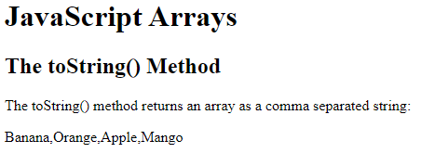
JavaScript Array Methods
JavaScript Array toString()
JavaScript calls the toString method automatically when an array is to be represented as a text value or when an array is referred to in a string concatenation. Array. prototype. toString recursively converts each element, including other arrays, to strings.
Example
const fruits = ["Banana", "Orange", "Apple", "Mango"];
document.getElementById("demo").innerHTML = fruits.toString();
Result:
Banana,Orange,Apple,Mango
<html><body>
<h1>JavaScript Arrays</h1>
<h2>The toString() Method</h2>
<p>The toString() method returns an array as a comma separated string:</p>
<p id="demo"></p>
<script>
const fruits = ["Banana", "Orange", "Apple", "Mango"];
document.getElementById("demo").innerHTML = fruits.toString();
</script></body></html>

Slide 79
JavaScript Array Methods
The join() method also joins all array elements into a string.
It behaves just like toString(), but in addition you can specify the separator:
Example
const fruits = ["Banana", "Orange", "Apple", "Mango"];
document.getElementById("demo").innerHTML = fruits.join(" * ");
Result:
Banana * Orange * Apple * Mango
Popping and Pushing
When you work with arrays, it is easy to remove elements and add new elements.
This is what popping and pushing is:
Popping items out of an array, or pushing items into an array.
JavaScript Array pop()
The pop() method removes the last element from an array:
Example
const fruits = ["Banana", "Orange", "Apple", "Mango"];
fruits.pop();

Slide 80
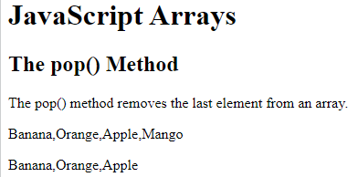
JavaScript Array Methods
<html>
<body>
<h1>JavaScript Arrays</h1>
<h2>The pop() Method</h2>
<p>The pop() method removes the last element from an array.</p>
<p id="demo1"></p>
<p id="demo2"></p>
<script>
const fruits = ["Banana", "Orange", "Apple", "Mango"];
document.getElementById("demo1").innerHTML = fruits;
fruits.pop();
document.getElementById("demo2").innerHTML = fruits;
</script></body></html>
JavaScript Array push()
The push() method adds a new element to an array (at the end):
Example
const fruits = ["Banana", "Orange", "Apple", "Mango"];
fruits.push("Kiwi");

Slide 81
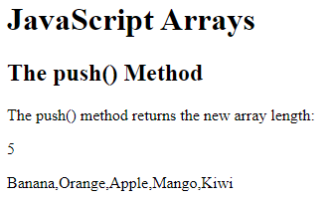
JavaScript Array Methods
<!DOCTYPE html>
<html>
<body>
<h1>JavaScript Arrays</h1>
<h2>The push() Method</h2>
<p>The push() method returns the new array length:</p>
<p id="demo1"></p>
<p id="demo2"></p>
<script>
const fruits = ["Banana", "Orange", "Apple", "Mango"];
document.getElementById("demo1").innerHTML = fruits.push("Kiwi");
document.getElementById("demo2").innerHTML = fruits;
</script></body></html>

Slide 82
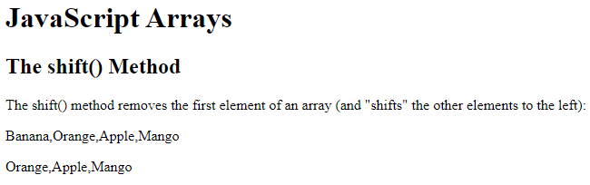
JavaScript Array Methods
Shifting Elements
Shifting is equivalent to popping, but working on the first element instead of the last.
JavaScript Array shift()
The shift() method removes the first array element and "shifts" all other elements to a lower index.
Example
const fruits = ["Banana", "Orange", "Apple", "Mango"];
fruits.shift();
<html><body>
<h1>JavaScript Arrays</h1>
<h2>The shift() Method</h2>
<p>The shift() method removes the first element of an array (and "shifts" the other elements to the left):</p>
<p id="demo1"></p>
<p id="demo2"></p>
<script>
const fruits = ["Banana", "Orange", "Apple", "Mango"];
document.getElementById("demo1").innerHTML = fruits;
fruits.shift();
document.getElementById("demo2").innerHTML = fruits;
</script></body></html>

Slide 83
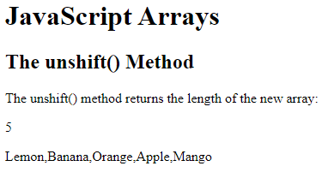
JavaScript Array Methods
JavaScript Array unshift()
The unshift() method adds a new element to an array (at the beginning), and "unshifts" older elements:
Example
const fruits = ["Banana", "Orange", "Apple", "Mango"];
fruits.unshift("Lemon");
The unshift() method returns the new array length:
<html><body>
<h1>JavaScript Arrays</h1>
<h2>The unshift() Method</h2>
<p>The unshift() method returns the length of the new array:</p>
<p id="demo1"></p>
<p id="demo2"></p>
<script>
const fruits = ["Banana", "Orange", "Apple", "Mango"];
document.getElementById("demo1").innerHTML = fruits.unshift("Lemon");
document.getElementById("demo2").innerHTML = fruits;
</script></body></html>

Slide 84
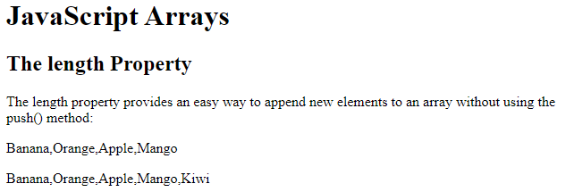
JavaScript Array
JavaScript Array length: The length property provides an easy way to append a new element to an array:
Example
const fruits = ["Banana", "Orange", "Apple", "Mango"];
fruits[fruits.length] = "Kiwi";
<!DOCTYPE html>
<html>
<body>
<h1>JavaScript Arrays</h1>
<h2>The length Property</h2>
<p>The length property provides an easy way to append new elements to an array without using the push() method:</p>
<p id="demo1"></p>
<p id="demo2"></p>
<script>
const fruits = ["Banana", "Orange", "Apple", "Mango"];
document.getElementById("demo1").innerHTML = fruits;
fruits[fruits.length] = "Kiwi";
document.getElementById("demo2").innerHTML = fruits;
</script>
</body>
</html>

Slide 85
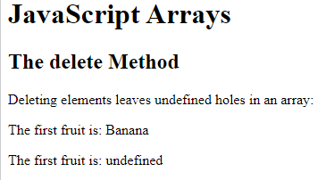
JavaScript Array
JavaScript Array delete
Array elements can be deleted using the JavaScript operator delete.
Using delete leaves undefined holes in the array.
Use pop() or shift() instead.
Example
const fruits = ["Banana", "Orange", "Apple", "Mango"];
delete fruits[0];
<html><body>
<h1>JavaScript Arrays</h1>
<h2>The delete Method</h2>
<p>Deleting elements leaves undefined holes in an array:</p>
<p id="demo1"></p>
<p id="demo2"></p>
<script>
const fruits = ["Banana", "Orange", "Apple", "Mango"];
document.getElementById("demo1").innerHTML =
"The first fruit is: " + fruits[0];
delete fruits[0];
document.getElementById("demo2").innerHTML =
"The first fruit is: " + fruits[0];
</script></body></html>

Slide 86
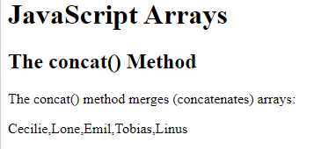
JavaScript Array Methods
Merging (Concatenating) Arrays
The concat() method creates a new array by merging (concatenating) existing arrays:
<html>
<body>
<h1>JavaScript Arrays</h1>
<h2>The concat() Method</h2>
<p>The concat() method merges (concatenates) arrays:</p>
<p id="demo"></p>
<script>
const myGirls = ["Cecilie", "Lone"];
const myBoys = ["Emil", "Tobias", "Linus"];
const myChildren = myGirls.concat(myBoys);
document.getElementById("demo").innerHTML = myChildren;
</script></body></html>

Slide 87
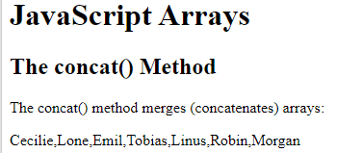
JavaScript Array Methods
The concat() method does not change the existing arrays. It always returns a new array.
The concat() method can take any number of array arguments:
Example (Merging Three Arrays)
<!DOCTYPE html>
<html><body>
<h1>JavaScript Arrays</h1>
<h2>The concat() Method</h2>
<p>The concat() method merges (concatenates) arrays:</p>
<p id="demo"></p>
<script>
const array1 = ["Cecilie", "Lone"];
const array2 = ["Emil", "Tobias", "Linus"];
const array3 = ["Robin", "Morgan"];
const myChildren = array1.concat(array2, array3);
document.getElementById("demo").innerHTML = myChildren;
</script></body></html>

Slide 88
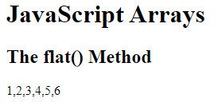
JavaScript Array Methods
Flattening an Array
Flattening an array is the process of reducing the dimensionality of an array.
The flat() method creates a new array with sub-array elements concatenated to a specified depth.
Example
const myArr = [[1,2],[3,4],[5,6]];
const newArr = myArr.flat();
<html>
<body>
<h1>JavaScript Arrays</h1>
<h2>The flat() Method</h2>
<p id="demo"></p>
<script>
const myArr = [[1,2],[3,4],[5,6]];
const newArr = myArr.flat();
document.getElementById("demo").innerHTML = newArr;
</script></body></html>

Slide 89
JavaScript Array Methods
<!DOCTYPE html>
<html lang="en">
<head>
<meta charset="UTF-8">
<meta http-equiv="X-UA-Compatible" content="IE=edge">
<meta name="viewport" content="width=device-width, initial-scale=1.0">
<title>Document</title>
</head>
<body>
<h1>Array Methods</h1>
<script>
var a=[10,20,30,40]
var b=[50,60,70,80]
document.writeln(a.join("$")+"<br>")
var c=["xyz","ghi","def","abc"]
document.writeln(c.sort()+"<br>")
document.writeln(a.reverse()+"<br>")
document.writeln("a="+a+"<br>")
document.writeln("b="+b+"<br>")
document.writeln(a.pop()+"<br>")
document.writeln("a="+a+"<br>")
Array Methods
10$20$30$40
abc,def,ghi,xyz
40,30,20,10
a=40,30,20,10
b=50,60,70,80
10
a=40,30,20
4
a=40,30,20,10
40
a=30,20,10
4
a=50,30,20,10

Slide 90
JavaScript Array Methods
document.writeln(a.push("10")+"<br>")
document.writeln("a="+a+"<br>")
document.writeln(a.shift()+"<br>")
document.writeln("a="+a+"<br>")
document.writeln(a.unshift("50")+"<br>")
document.writeln("a="+a+"<br>")
document.writeln(a.concat(b)+"<br>")
document.writeln("a="+a+"<br>")
document.writeln(a.concat("100")+"<br>")
document.writeln("a="+a+"<br>")
document.writeln(a.splice(1,0,"40","60")+"<br>")
document.writeln("a="+a+"<br>")
document.writeln(a.splice(3,2,"70")+"<br>")
document.writeln("a="+a+"<br>")
document.writeln(a.splice(3,2)+"<br>")
document.writeln("a="+a+"<br>")
var n=[100,200,300,400,500,600,700]
document.writeln("n="+n+"<br>")
document.writeln(n.slice(0,4)+"<br>")
</script>
</body>
</html>
50,30,20,10,50,60,70,80
a=50,30,20,10
50,30,20,10,100
a=50,30,20,10
a=50,40,60,30,20,10
30,20
a=50,40,60,70,10
70,10
a=50,40,60
100,200,300,400
n=100,200,300,400,500,600,700

Slide 91
Objects
A javaScript object is an entity having state and behavior (properties and method). For example: car, pen, bike, chair, glass, keyboard, monitor etc.
JavaScript is an object-based language. Everything is an object in JavaScript.
JavaScript is template based not class based. Here, we don't create class to get the object. But, we direct create objects.
Creating Objects in JavaScript
There are 3 ways to create objects.
By object literal
By creating instance of Object directly (using new keyword)
By using an object constructor (using new keyword)

Slide 92

Objects
1) JavaScript Object by object literal
The syntax of creating object using object literal is given below:
object={property1:value1,property2:value2.....propertyN:valueN}
As you can see, property and value is separated by : (colon).
Example
<script>
emp={id:102,name:"Shyam Kumar",salary:40000}
document.write(emp.id+" "+emp.name+" "+emp.salary);
</script>

Slide 93
Objects
By creating instance of Object
The syntax of creating object directly is given below:
var objectname=new Object();
Here, new keyword is used to create object.
Example
<script>
var emp=new Object();
emp.id=101;
emp.name="Ravi Malik";
emp.salary=50000;
document.write(emp.id+" "+emp.name+" "+emp.salary);
</script>

Slide 94

Objects
By using an Object constructor
Here, you need to create function with arguments. Each argument value can be assigned in the current object by using this keyword.
example
<script>
function emp(id,name,salary){
this.id=id;
this.name=name;
this.salary=salary;
}
e=new emp(103,"Vimal Jaiswal",30000);
document.write(e.id+" "+e.name+" "+e.salary);

Slide 95
Date object
JavaScript Date Object
The JavaScript date object can be used to get year, month and day. You can display a timer on the webpage by the help of JavaScript date object.
You can use different Date constructors to create date object. It provides methods to get and set day, month, year, hour, minute and seconds.
Constructor
You can use 4 variant of Date constructor to create date object.
Date()
Date(milliseconds)
Date(dateString)
Date(year, month, day, hours, minutes, seconds, milliseconds)

Slide 96
Date object
JavaScript Date Object
The JavaScript date object can be used to get year, month and day. You can display a timer on the webpage by the help of JavaScript date object.
You can use different Date constructors to create date object. It provides methods to get and set day, month, year, hour, minute and seconds.
Constructor
You can use 4 variant of Date constructor to create date object.
Date()
Date(milliseconds)
Date(dateString)
Date(year, month, day, hours, minutes, seconds, milliseconds)

Slide 97
Date object
Example
<html>
<body>
Current Date and Time: <span id="txt"></span>
<script>
var today=new Date();
document.getElementById('txt').innerHTML=today;
</script>
</body>
</html>

Slide 98
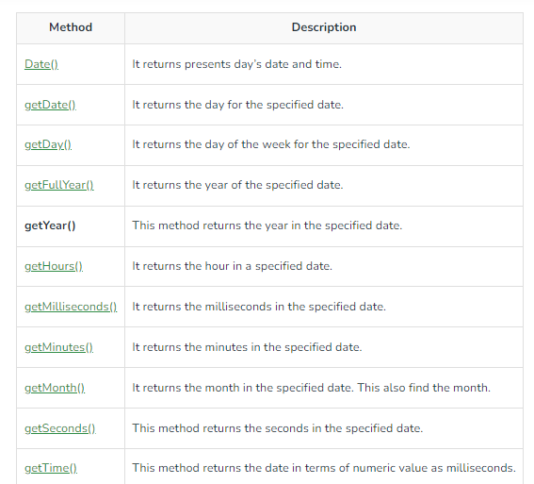
Date object methods

Slide 99
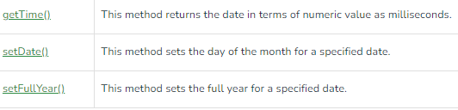
Date object methods

Slide 100

Date object
Let's see another code to print date/month/year.
<script>
var date=new Date();
var day=date.getDate();
var month=date.getMonth()+1;
var year=date.getFullYear();
document.write("<br>Date is: "+day+"/"+month+"/"+year);
</script>

Slide 101

Date object
JavaScript Current Time Example
Current Time: <span id="txt"></span>
<script>
var today=new Date();
var h=today.getHours();
var m=today.getMinutes();
var s=today.getSeconds();
document.getElementById('txt').innerHTML=h+":"+m+":"+s;
</script>

Slide 102
Date object
JavaScript Digital Clock Example
Current Time: <span id="txt"></span>
<script>
function getTime(){
var today=new Date();
var h=today.getHours();
var m=today.getMinutes();
var s=today.getSeconds();
document.getElementById('txt').innerHTML=h+":"+m+":"+s;
}
setInterval("getTime()",1000);
</script>

Slide 103
Objects
<h1>Date Object</h1>
<script>
document.writeln("<h2>")
var d1=new Date()
document.writeln(d1+"<br>")
var d2=new Date(2023,0,22,15,22,50,100)
document.writeln(d2+"<br>")
var d3=new Date(2023,0,22,15,22)
document.writeln(d3+"<br>")
var d4=new Date(2023,0,22)
document.writeln(d4+"<br>")
var d5=new Date(2023)
document.writeln(d5+"<br>")
Thu Jun 15 2023 21:46:40 GMT+0530 (India Standard Time)
Sun Jan 22 2023 15:22:50 GMT+0530 (India Standard Time)
Sun Jan 22 2023 15:22:00 GMT+0530 (India Standard Time)
Sun Jan 22 2023 00:00:00 GMT+0530 (India Standard Time)
Thu Jan 01 1970 05:30:02 GMT+0530 (India Standard Time)

Slide 104
Objects
var d6=new Date(-2023)
document.writeln(d6+"<br>")
document.writeln("year="+d1.getFullYear()+"<br>")
document.writeln("Month="+d1.getMonth()+"<br>")
document.writeln("Date="+d1.getDate()+"<br>")
document.writeln("Day="+d1.getDay()+"<br>")
document.writeln("Hours="+d1.getHours()+"<br>")
document.writeln("Minutes="+d1.getMinutes()+"<br>")
</script>
Thu Jan 01 1970 05:29:57 GMT+0530 (India Standard Time)
year=2023
Month=5
Date=15
Day=4
Hours=21
Minutes=46

Slide 105
The Browser Object Model (BOM)
The Browser Object Model (BOM) is used to interact with the browser.
The default object of browser is window means you can call all the functions of window by specifying window or directly. For example:
alert("cancel");
Is same as
window.alert("cancel”);

Slide 106
Window object
properties of Window Object
Document- Returns the Document object for the window.
See also The Document Object.
innerWidth -Returns the width of a window's content area (viewport) including scrollbars
outerWidth-Returns the width of the browser window, including toolbars/scrollbars
innerHeight-Returns the height of the window's content area (viewport) including scrollbars
outerHeight-Returns the height of the browser window, including toolbars/scrollbars
Location -Returns the Location object for the window.See also the The Location Object.
Closed- Returns a boolean true if a window is closed.
Name- Sets or returns the name of a window
Navigator- Returns the Navigator object for the window.
See also The Navigator object.

Slide 107
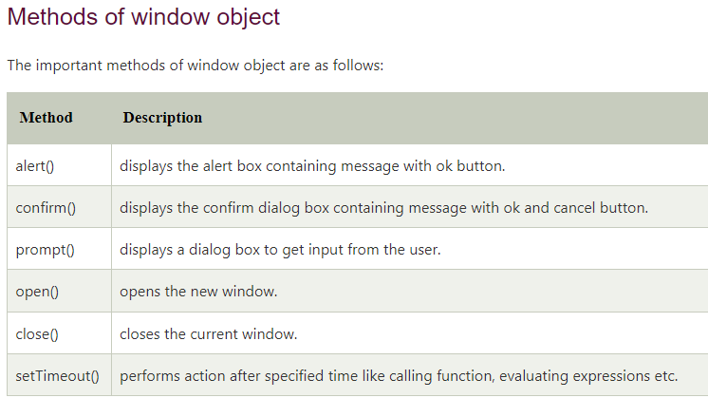
Window object

Slide 108
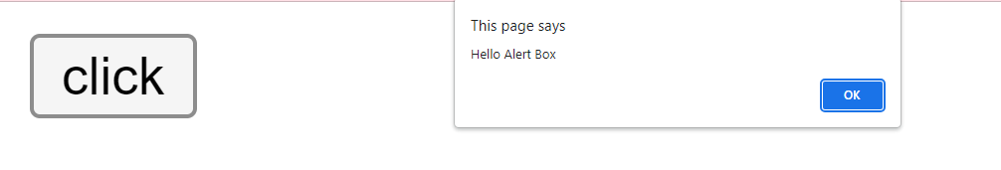
Window object
Example of alert() in javascript
It displays alert dialog box. It has message and ok button
example
<script type="text/javascript">
function msg(){
alert("Hello Alert Box");
}
</script>
<input type="button" value="click" onclick="msg()"/>
.

Slide 109
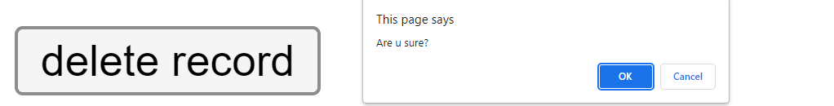
Window object
Example of confirm() in javascript
It displays the confirm dialog box. It has message with ok and cancel buttons.
<script type="text/javascript">
function msg(){
var v= confirm("Are u sure?");
if(v==true){
alert("ok");
}
else{
alert("cancel");
}
}
</script>
<input type="button" value="delete record" onclick="msg()"/>
.

Slide 110

Window object
Example of prompt() in javascript
It displays prompt dialog box for input. It has message and textfield.
<script type="text/javascript">
function msg(){
var v= prompt("Who are you?");
alert("I am "+v);
}
</script>
<input type="button" value="click" onclick="msg()"/>
.

Slide 111
Window object
Example of open() in javascript
It displays the content in a new window.
<script type="text/javascript">
function msg(){
open("variable.html");
}
</script>
<input type="button" value="javatpoint" onclick="msg()"/>
.

Slide 112

Window object
Example of setTimeout() in javascript
It performs its task after the given milliseconds.
<body>
<h1>The Window Object</h1>
<h2>The setTimeout() Method</h2>
<p>Wait 5 seconds for the greeting:</p>
<h2 id="demo"></h2>
<script>
const myTimeout = setTimeout(myGreeting, 5000);
function myGreeting() {
document.getElementById("demo").innerHTML = "Happy Birthday!"
}
</script>
</body>
.

Slide 113
Functions
What is Function: A block of code written to do a particular task
What is Block: Anything that enclosed between { }
Ex:
{
statement 1:
statement 2;
statement n:
}
return and parameters are optional
Named function:
function functionName(parameter1,parameter2...parameter n) {
body
return value;
}

Slide 114
Functions
Ex: function sum(num1,num2) {
var result = num1+num2
return result;
}
<script>
Function sum(num1,num2)
{
var result num1+num2
return result;
}
console.log(sum(6,7));
Document.write(sum(10,15));
Document.write(“<br>sum of 50,100:”+sum(50,100));
</script>
How to call functions:
functionName(parameters)
Ex: sum(7,8)

Slide 115
Functions
What is function expression:
Assigning function to a variable
Ex:
add= function sum(num1,num2) {
var result = num1+num2;
return result;
}
<script>
var add = function sum(num1,num2){
var result = num1+num2
return result;
}
var res =add(10,7);
document.write(res);
</script>

Slide 116
Types of Functions
Types: Named functions
Anonymous function
Immediately Invoked function expression(IIFE)
Arrow function
Named function:
function functionName(parameteri,parameter2...parameter n)
{
body
return value;
}
Ex: function sum(num1,num2)
{
var result = numi+num2
return result;
}

Slide 117
Types of Functions
Anonymous function:
function (parameter1,parameter2...parameter n)
{
body
return value;
}
Ex: function (numi,num2)
{
var result = numi+num2
return result;
}
<script>
var sum = function(num,num2)
{
var result =num1+num2;
return result;
}
document.write(sum(6,7))
</script>

Slide 118
Types of Functions
When we want to execute a function immediately where they Created,IIFE used.
Syntax: (function definition) ();
Ex: (function product (num1,num2)
{
var result = num1*num2
return result;
}
) (6,8);
<script>
var sum=(function add(num,num2){
var result = num1+num2 ;
return result;
})(5,7);
document.write(sum);
</script>

Slide 119
Types of Functions
Arrow function:
var any name =(parameter1,parameter2...parameter n)=>
{
body
return value;
}
Ex:
<script>
var product= (num1,num2)=>{
var result =num1*num2;
return result;
}
document.write(product (7,5))
</script>

Slide 120
Types of Functions
Arrow function forms:
If only one statement in function body var product = (num1,num2) => num1*num2
Ex: <script>
product =(num1,num2) =>num1*num2;
document.write(product (7,5))
</script>
2. If only one parameter
var cube = num1 => num1 *num1* num1 (or) var cube = (num1)=> num1* num1*num1
(Or) var cube = (num1) => { return num1*num1*num1 } (calling: cube(5))
Ex: <script>
product = num1=>num1*num1*num1
document.write(product(7))
</script>

Slide 121
Types of Functions
3. If no argument
var greet =()=> console.log("Good Morning");
(Or) var greet =_ => console.log("Good Morning");
Ex:
<script>
greet= () =>{
document.write("Hello Good morning")
document.write("<br> Welcome")
return 6+4`
}
var res = greet()
document.write("<br>" + res);
</script>

Slide 122
pattern matching with Regular Expressions
A regular expression is a sequence of characters that forms a search pattern.
When you search for data in a text, you can use this search pattern to describe what you are searching for.
A regular expression can be a single character, or a more complicated pattern.
Regular expressions can be used to perform all types of text search and text replace operations.

Slide 123
pattern matching with Regular Expressions
Create a RegEx
There are two ways you can create a regular expression in JavaScript.
Using a regular expression literal:
The regular expression consists of a pattern enclosed between slashes /.
Syntax: /pattern/
(or)
/pattern/flag
Example:
var regexLiteral = /abc/; Here the flags are optional

Slide 124

pattern matching with Regular Expressions
Using the RegExp() constructor function:
You can also create a regular expression by calling the RegExp() constructor function.
syntax
new RegExp(pattern)
new RegExp(pattern, flags)
Example:
var regex = new RegExp('abc');

Slide 125
pattern matching with Regular Expressions
There are mainly two methods for testing regular expressions.
1.test()
2.exec()
1.test() : This method is used to test whether a match has been found or not. It accepts a string which we have to test against regular expression and returns true or false depending upon if the match is found or not.
Example
var regex = /hello/;
var str = 'hello world';
var result = regex.test(str);
console.log(result);
// returns true

Slide 126
pattern matching with Regular Expressions
<!DOCTYPE html>
<html>
<body>
<h2>JavaScript Regular Expressions</h2>
<p>Search for an "e" in the next paragraph:</p>
<p id="p01">The best things in life are free!</p>
<p id="demo"></p>
<script>
let text = document.getElementById("p01").innerHTML;
const pattern = /e/;
document.getElementById("demo").innerHTML = pattern.test(text);
</script>
</body>
</html>
Output:JavaScript Regular Expressions
Search for an "e" in the next paragraph:
The best things in life are free!
true

Slide 127
pattern matching with Regular Expressions
2.exec() : This method returns an array containing all the matched groups.
It accepts a string that we have to test against a regular expression.
For example:
var regex = /hello/
;var str = 'hello world';
var result = regex.exec(str);
console.log(result);
// returns [ 'hello', index: 0, input: 'hello world', groups: undefined ]
// 'hello' -> is the matched pattern. // index: -> Is where the regular expression starts. // input: -> Is the actual string passed.

Slide 128

pattern matching with Regular Expressions
<!DOCTYPE html>
<html>
<body>
<script>
let re=/hello/g
let res=re.exec("hello javascript hello")
console.log(res);
console.log(res.index);
res=re.exec("hello javascript hello")
console.log(res);
console.log(res.index);
</script>
</body>
</html>

Slide 129
pattern matching with Regular Expressions
Flags:
Regular expressions have flags or modifiers. Let’s discuss the most important flags:
g — Global search, don’t return after the first match
i — Case-insensitive search
M--Perform multiline matching
You can also combine the flags in a single regular expression. Note that their order doesn’t have any effect on the result.

Slide 130
pattern matching with Regular Expressions
Regular Expression Literal — Syntax: /pattern/flags
Example
var regexGlobal = /abc/g;
console.log(regexGlobal.test('abc abc'));
// it will match all the occurence of 'abc', so it won't return after first match..
var regexInsensitive = /abc/i;
console.log(regexInsensitive.test('Abc'));
// returns true, because the case of string characters don't matter in case-insensitive search.

Slide 131
pattern matching with Regular Expressions
Regular Expression Constructor — Syntax: new RegExp('pattern', 'flags')
Example
var regexGlobal = new RegExp('abc','g');
console.log(regexGlobal.test('abc abc'));
// it will match all the occurence of 'abc', so it won't return after first match.
var regexInsensitive = new RegExp('abc','i');
console.log(regexInsensitive.test('Abc'));
// returns true, because the case of string characters don't matter in case-insensitive search.

Slide 132

pattern matching with Regular Expressions
<script>
var regex = new RegExp(/hello/ig);
var str = 'hello world Hello';
var result = regex.exec(str);
console.log(result);
var result = regex.exec(str);
console.log(result);
</script>

Slide 133
pattern matching with Regular Expressions
Character groups
Character set [xyz]: A character set is a way to match different characters in a single position, it matches any single character in the string from characters present inside the brackets.
Example:
var regex = /[bt]ear/;
console.log(regex.test('tear')); // returns true console.log(regex.test('bear')); // return true console.log(regex.test('fear')); // return false
Negated character set [^xyz] : It matches anything that is not enclosed in the brackets.
Example:
var regex = /[^bt]ear/;
console.log(regex.test('tear')); // returns false console.log(regex.test('bear')); // return false console.log(regex.test('fear')); // return true

Slide 134
pattern matching with Regular Expressions
Ranges [a-z] : Suppose we want to match all of the letters of an alphabet in a single position, we could write all the letters inside the brackets, but there is an easier way and that is ranges.
For example: [a-h] will match all the letters from a to h. Ranges can also be digits like [0-9] or capital letters like [A-Z].
var regex = /[a-z]ear/;
console.log(regex.test('fear')); // returns true
console.log(regex.test('tear')); // returns true

Slide 135
pattern matching with Regular Expressions
ExpressionDescription
[abc]Find any character between the brackets
[^abc]Find any character NOT between the brackets
[0-9]Find any character between the brackets (any digit)
[^0-9]Find any character NOT between the brackets (any non-digit)
(x|y)Find any of the alternatives specified

Slide 136
pattern matching with Regular Expressions
Meta characters
Meta-characters are characters with a special meaning. There are many meta character but I am going to cover the most important ones here.
\d — Match any digit character ( same as [0-9] ).
\w — Match any word character. A word character is any letter, digit, and underscore. (Same as [a-zA-Z0–9_] ) i.e alphanumeric character.
\s — Match a whitespace character (spaces).
\t — Match a tab character only.(tabs)
\b — Find a match at beginning or ending of a word. Also known as word boundary.
. — (period) Matches any character except for newline.
\D — Match any non digit character (same as [^0–9]).
\W — Match any non word character (Same as [^a-zA-Z0–9_] ).
\S — Match a non whitespace character.

Slide 137
pattern matching with Regular Expressions
Quantifiers
Quantifiers are symbols that have a special meaning in a regular expression.
+ — Matches the preceding expression 1 or more times.
var regex = / \d+/; console.log(regex.test('8')); // true
console.log(regex.test('88899')); // true
console.log(regex.test('8888845')); // true
* —Matches the preceding expression 0 or more times.
var regex = /go*d/;
console.log(regex.test('gd')); // true
console.log(regex.test('god')); // true
console.log(regex.test('good')); // true
console.log(regex.test('goood')); // true

Slide 138
pattern matching with Regular Expressions
? — Matches the preceding expression 0 or 1 time, that is preceding pattern is optional.
var regex = /goo?d/;
console.log(regex.test('god')); // true
console.log(regex.test('good')); // true
console.log(regex.test('goood')); // false
^ — Matches the beginning of the string, the regular expression that follows it should be at the start of the test string. i.e the caret (^) matches the start of string.
var regex = /^g/;
console.log(regex.test('good')); // true
console.log(regex.test('bad')); // false
console.log(regex.test('tag')); // false

Slide 139
pattern matching with Regular Expressions
$ — Matches the end of the string, that is the regular expression that precedes it should be at the end of the test string. The dollar ($) sign matches the end of the string.
Example
var regex = /.com$/;
console.log(regex.test('test@testmail.com')); // true
console.log(regex.test('test@testmail')); // false
{N,} — Matches at least N occurrences of the preceding regular expression.
Example
var regex = /go{2,}d/;
console.log(regex.test('good')); // true
console.log(regex.test('goood')); // true
console.log(regex.test('gooood')); // true

Slide 140
pattern matching with Regular Expressions
{N,M} — Matches at least N occurrences and at most M occurrences of the preceding regular expression (where M > N).
Example
var regex = /go{1,2}d/;
console.log(regex.test('god')); // true
console.log(regex.test('good')); // true
console.log(regex.test('goood')); // false
Alternation X|Y — Matches either X or Y.
Example:
var regex = /(green|red) apple/;
console.log(regex.test('green apple')); // true console.log(regex.test('red apple')); // true console.log(regex.test('blue apple')); // false

Slide 141
pattern matching with Regular Expressions
QuantifierDescription
n+Matches any string that contains at least one n
n*Matches any string that contains zero or more occurrences of n
n?Matches any string that contains zero or one occurrences of n
n{X}Matches any string that contains a sequence of X n's
n{X,Y}Matches any string that contains a sequence of X to Y n's
n{X,}Matches any string that contains a sequence of at least X n's
n$Matches any string with n at the end of it
^nMatches any string with n at the beginning of it
?=nMatches any string that is followed by a specific string n
?!nMatches any string that is not followed by a specific string n

Slide 142
pattern matching with Regular Expressions
Using String Methods: In JavaScript, regular expressions are often used with the two string methods: search() and replace().
The search() method uses an expression to search for a match and returns the position of the match.
The replace() method returns a modified string where the pattern is replaced.

Slide 143

pattern matching with Regular Expressions
Example for search()
<script>
function myFunction() {
// input string
let str = "Visit hello students!";
// searching string with modifier i
let n = str.search(/hello students/i);
console.log(n);
// searching string without modifier i
n = str.search(/Hello students/);
console.log(n);
}
myFunction();
</script>

Slide 144
pattern matching with Regular Expressions
<html>
<body>
<script>
const string = 'Hello hello hello';
// performing a replacement
const result1 = string.replace(/hello/, 'world');
console.log(result1); // Hello world hello
// performing global replacement
const result2 = string.replace(/hello/g, 'world');
console.log(result2); // Hello world world
// performing case-insensitive replacement
const result3 = string.replace(/hello/i, 'world');
console.log(result3); // world hello hello
// performing global case-insensitive replacement
const result4 = string.replace(/hello/gi, 'world');
console.log(result4); // world world world
</script>
</body>
</html>

Slide 145
pattern matching with Regular Expressions
Use String replace() With a Regular Expression :
<script>
function myFunction() {
// input string
let str = "Please visit hi!";
// replacing with modifier i
let txt = str.replace(/Hi/i, "hello students");
console.log(txt);
}
myFunction();
</script>

Slide 146
EMPLOYEE id validation using Regular Expressions
<script>
function validate()
{
var username=document.getElementById("uname").value;
var regx=/^[IARE]\d{5}$/i;
if(regx.test(username))
{
alert("valid username");
}
else
{
alert("invalid username");
document.getElementById("name").style.visibility="visible";
}
}

Slide 147

EMPLOYEE id validation using Regular Expressions
</script>
</head>
<body>
<form>
<input id="uname" placeholder="username" type="text"/><br>
<label id="name" style="color:red;visibility:hidden">invalid username</label>
<br>
<button onclick="validate()" type="button">submit</button>
</form>

Slide 148
Mobile no validation using Regular Expressions
<script>
function validate()
{
var mobileno=document.getElementById("mobile").value;
var regx=/^[6-9]\d{9}$/;
if(regx.test(mobileno))
{
document. (getElementById"name").innerHTML="valid mobile no";
document.getElementById("name").style.visibility="visible";
document.getElementById("name").style.color="green";
}

Slide 149
Mobile no validation using Regular Expressions
else
{
document.getElementById("name").innerHTML="invalid mobile no";
document.getElementById("name").style.visibility="visible";
document.getElementById("name").style.color="red";
}
}
</script>
</head>

Slide 150
Mobile no validation using Regular Expressions
<body>
<form>
<input id="mobile" placeholder="mobileno" type="text"/><br>
<label id="name" style="visibility:hidden"></label>
<br>
<button onclick="validate()" type="button">submit</button>
</form>

Slide 151
Mail id validation using Regular Expressions
<script>
function validate()
{
var email=document.getElementById("mail").value;
// var regx=/^[a-z]{1}.[a-z]+@iare.ac.in$/;
var regx=new RegExp(var regx=new RegExp("^[a-z A-Z 0-9]+[._][a-z A-Z 0-9]+@[a-z]+[.]com$")
if(regx.test(email))
{
alert("valid mailid");
}
else
{
alert("invalid mailid");
document.getElementById("name").style.visibility="visible";
}
}
</script>
</head>

Slide 152
Mail id validation using Regular Expressions
<body>
<form>
<input id="mail" placeholder="email" type="text"/><br>
<label id="name" style="color:red;visibility:hidden">invalid username</label>
<br>
<button onclick="validate()" type="button">submit</button>
</form>

Slide 153
oops in javascript
Class Implementation in JavaScript
JavaScript uses the ES6 standard to define classes. Consider the following example
<script>
class Cars {
constructor(name, maker, price) {
this.name = name;
this.maker = maker;
this.price = price;
}
getDetails(){
return (`The name of the car is ${this.name}.`)
}
}

Slide 154

oops in javascript
let car1 = new Cars('Rolls Royce Ghost', 'Rolls Royce', '$315K');
let car2 = new Cars('Mercedes AMG One', 'Mercedes', '$2700K');
console.log(car1.name);
console.log(car2.maker);
console.log(car1.getDetails());
</script>

Slide 155
oops in javascript
Inheritance: It is a concept in which some properties and methods of an Object are being used by another Object. Unlike most of the OOP languages where classes inherit classes, JavaScript Objects inherit Objects i.e. certain features (property and methods) of one object can be reused by other Objects.
Example
<script>
class person {
constructor(name) {
this.name = name;
}
// method to return the string
toString() {
return (`Name of person: ${this.name}`);
}
}

Slide 156

oops in javascript
class student extends person {
constructor(name, id) {
// super keyword for calling the above
// class constructor
super(name);
this.id = id;
}
toString() {
return (`${super.toString()},
Student ID: ${this.id}`);
}
}
let student1 = new student('Mukul', 22);
console.log(student1.toString());
</script>

Slide 157
programs in javascript
<!--
Write a program that accepts three numbers from the user
and alerts back the the user: the sum of the numbers,
the total of the numbers multiplied together, the average
of the numbers, and, for extra credit, figure out how to
find the largest number and smallest number.
-->
<!DOCTYPE HTML>
<HTML>
<HEAD>
<TITLE>Javascript Math is the Coolest</title>
</HEAD>

Slide 158
programs in javascript
<BODY>
<SCRIPT type="text/javascript">
x = parseInt(prompt("Give me a first number."));
y = parseInt(prompt("Give me a second number."));
z = parseInt(prompt("Give me a third number."));
sum = x + y + z;
product = x * y * z;
average = sum / 3;
//finding the largest number using nested ifs; an array would be more straightforward,
//so we can work this part again after we learn arrays.
if (x > y)
{
if (x > z)
{
largest = x;
}
else if (z > x)
{
largest = z;
}
}

Slide 159
programs in javascript
else if (y > x)
{
if (y > z)
{
largest = y;
}
else if (z > x)
{
largest = z;
}
}
else if (x == y)
{
if (x == z)
{
largest = x;
}
}

Slide 160
programs in javascript
//finidng the smallest number using nested ifs.
if (x < y)
{
if (x < z)
{
smallest = x;
}
else if (z < x)
{
smallest = z;
}
}
else if (y < x)
{
if (y < z)
{
smallest = y;
}
else if (z < x)
{
smallest = z;
}
}

Slide 161
programs in javascript
else if (x == y)
{
if (x == z)
{
smallest = x;
}
}
alert("The three numbers you gave me were: " + x + ", " + y + ", & " + z);
alert("The sum of is: " + sum);
alert("The product is: " + product);
alert("The average is: " + average);
alert("The largest number is: " + largest);
alert("The smallest number is: " + smallest);
</SCRIPT>
</BODY>
</HTML>

Slide 162
programs in javascript
Build a script that calculates the product of the odd integers from 1 to 15 <head>
<script>
function product()
{
var prod = 1;
var MAXVALUE = 15;
// Calculate product of odd integers from 1 to 15. To get the odd values, increment the counter by 2.
for (var i=1; i<=MAXVALUE; i+=2){
prod = prod * i;
}
document.writeln(prod);
}
</script></head>

Slide 163
programs in javascript
Build a Javascript program to define a user defined function for sorting the values in an array
<body>
<script>
function sort()
{ let arr=[50,60,10,30,80];
let temp=0;
var i,j;
for (i = 0; i < arr.length; i++) {
for (j = i+1; j < arr.length; j++) {
if(arr[i] > arr[j]) {
temp = arr[i];
arr[i] = arr[j];
arr[j] = temp;
}}}
document.writeln("Elements of array sorted in ascending order: ");

Slide 164
programs in javascript
for ( i = 0; i < arr.length; i++) {
document.writeln(arr[i] + " ");
} }
</script>
<button type="button" onclick="sort()">click</button>
</body>

Slide 165
programs in javascript
Develop javascript program to display weather the given number is Armstrong numbers or not and display the result in the html form.
<body>
<script>
// program to check an Armstrong number of three digits
let sum = 0;
const number = prompt('Enter a three-digit positive integer: ');
// create a temporary variable
let temp = number;
while (temp > 0) {
// finding the one's digit
let remainder = temp % 10;
sum += remainder * remainder * remainder;
// removing last digit from the number
temp = parseInt(temp / 10); // convert float into integer
}

Slide 166
programs in javascript
// check the condition
if (sum == number) {
console.log("number is an Armstrong number");
}
else {
console.log("number is not an Armstrong number.");
}
</script>
</body>

Slide 167

programs in javascript
Build javascript code to display number, its square and cube in tabular format by reading the value from html form.(for n numbers)
<html>
<head>
</head>
<body>
<center>
<table border="1">
<tr><th>number</th><th>square</th><th>cube</th></tr>
<script>
var m=parseInt(prompt("enter a number"));
for(var i=0;i<=m;i++)
{
document.write("<tr><td>"+i+"</td><td>"+i*i+"</td><td>"+i*i*i+"</td></tr>");
}
</script>
</table>
</center>
</body>
</html>

Slide 168
How to remove duplicate elements from JavaScript Array ?
we will discuss the methods to remove duplicate elements from a Javascript array. There are various methods to remove duplicates in the array. We will discuss the most common four ways :
filter() method
set() method
forEach() Method
Below all the methods are described with proper examples:
Javascript filter() Method: The filter() method creates a new array of elements that pass the condition we provide. It will include only those elements for which true is returned. We can remove duplicate values from the array by simply adjusting our condition.

Slide 169


How to remove duplicate elements from JavaScript Array ?

Slide 170

How to remove duplicate elements from JavaScript Array ?

Slide 171
How to remove duplicate elements from JavaScript Array ?
Example: In this example, we will see the use of the filter() method.
let arr = ["apple", "mango", "apple", "orange", "mango", "mango"];
function removeDuplicates(arr) {
return arr.filter((item, index) => arr.indexOf(item) === index);
}
console.log(removeDuplicates(arr));
Output:
["apple", "mango", "orange"]

Slide 172

2) Remove duplicates from an array using a Set
A Set is a collection of unique values. To remove duplicates from an array:
First, convert an array of duplicates to a Set. The new Set will implicitly remove duplicate elements.
Then, convert the set back to an array.
The following example uses a Set to remove duplicates from an array:
<script>
let chars = ['A', 'B', 'A', 'C', 'B'];
let uniqueChars = [...new Set(chars)];
console.log(uniqueChars);
</script>
Spread operator

Slide 173



Slide 174

(Or) This method sets a new object type with ES6 (ES2015) that allows you to create collections of unique values.
let arr = ["apple", "mango", "apple", "orange", "mango", "mango"];
function removeDuplicates(arr) {
return [...new Set(arr)];
}
console.log(removeDuplicates(arr));

Slide 175
Javascript forEach() Method:
By using the forEach() method, we can iterate over the elements in the array, and we will push into the new array if it doesn’t exist in the array.
Example: In this example, we will see the use of the forEach() method.
let arr = ["apple", "mango", "apple", "orange", "mango", "mango"];
function removeDuplicates(arr) {
let unique = [];
arr.forEach((element) => {
if (!unique.includes(element)) {
unique.push(element);
}
});
return unique;
}
console.log(removeDuplicates(arr));

Slide 176



Slide 177
AJAX Introduction
AJAX - Asynchronous JavaScript And XML
AJAX helps in fetching data asynchronously from a remote web server
Data loaded by AJAX call is done asynchronously with out page refresh
Web server will send response which contains data that we have requested
Data can be of any format like JSON,XML...
Initially servers used to send data in XML format

Slide 178

AJAX Introduction
Asynchronous JavaScript: Asynchronous code allows the program to be executed immediately where the synchronous code will block further execution of the remaining code until it finishes the current one. This may not look like a big problem but when you see it in a bigger picture you realize that it may lead to delaying the User Interface.
Let us see the example how Asynchronous JavaScript runs.
document.write("Hi");
document.write("<br>");
setTimeout(() => {
document.write("Let us see what happens");
}, 2000);
document.write("<br>");
document.write("End");
document.write("<br>");

Slide 179

AJAX Introduction

Slide 180
AJAX Introduction
In JavaScript we have to use XMLHttpRequest object to make AJAX call
to exchange data from webserver.
AJAX request can be send to sever in with 3 steps
1. Create XMLHttpRequest object
Ex: let xhr = new XMLHttpRequest()
2. Create request with that object open() method
Syntax: open(method,url,async)
3. Send the request using send() method

Slide 181
AJAX Introduction
<body>
<div id="demo">
<h2>The XMLHttpRequest Object</h2>
<button type="button" onclick="loadDoc()">Change Content</button>
</div>
<body>
<script>
function loadDoc() {
var xhttp = new XMLHttpRequest();
xhttp.open("GET", "tes.txt", true);
xhttp.onreadystatechange = function() {
if (this.readyState == 4 && this.status == 200) {
document.getElementById("demo").innerHTML =
this.responseText;
}
}

Slide 182
AJAX Introduction
xhttp.send();
}
</script>
</body>
</html>
}

Slide 183
AJAX Introduction
Create a XMLHttpRequest Object :
var xhttp = new XMLHttpRequest();
Properties of XMLHttpRequest object :
readystate is a property of the XMLHttpRequest Object which holds the status of the XMLHttpRequest.
0: request not initialized
1: server connection established
2: request received
3: processing request
4: request finished and response is ready

Slide 184
AJAX Introduction
onreadystatechange``` is a property of the XMLHttpRequest Object which defines a function to be called when the readyState property changes.
```status``` is a property of the XMLHttpRequest Object which returns the status-number of a request
200: "OK"
403: "Forbidden"
404: "Not Found"
XMLHttpRequest Object Methods : To send a request to a Web Server, we use the open() and send() methods of the XMLHttpRequest object.
xhttp.open("GET", "content.txt", true);
xhttp.send();

